Slide 1
‘Panic like the
house is on fire’
Greta Thunberg speech to the
Members of the European Parliament
Present by Kevin Li

Slide 2
Main Idea
HELP OUR MOTHER EARTH
=

Slide 3
Quotes:
“But when your house is on fire and you want to keep your house from burning to the ground, then that does require some level of panic.”
“Our house is falling apart.”
“If our house was falling apart you wouldn’t say that you have the situation under control and place the future living conditions for all living species in the hands of inventions that are yet to be invented.”
“If the walls of our house truly came tumbling down, surely you would set your differences aside and start cooperating.”

Slide 4
Tone:
Serious
Stressful
Worry
Begging
Anxious

Slide 5
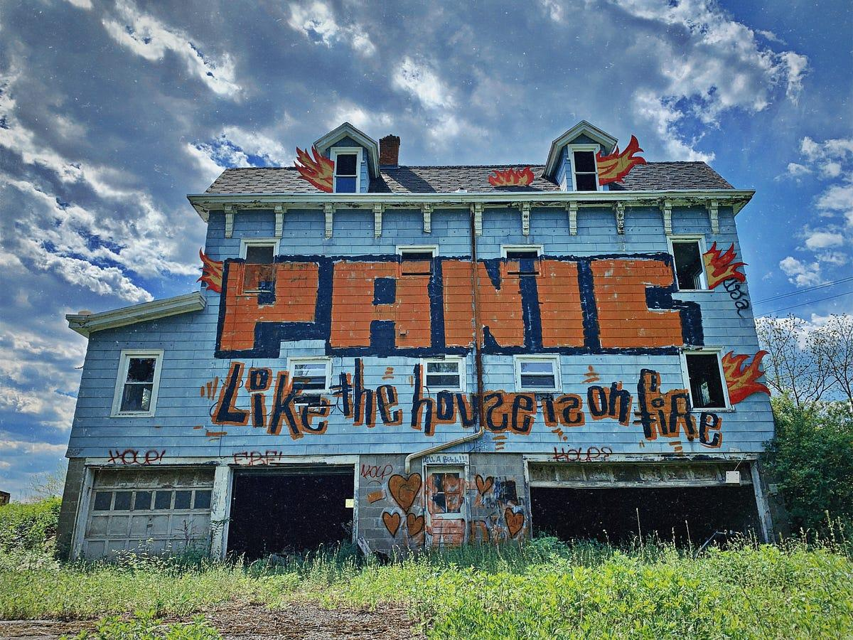

Slide 6
House is on fire
Earth is dying

Slide 7
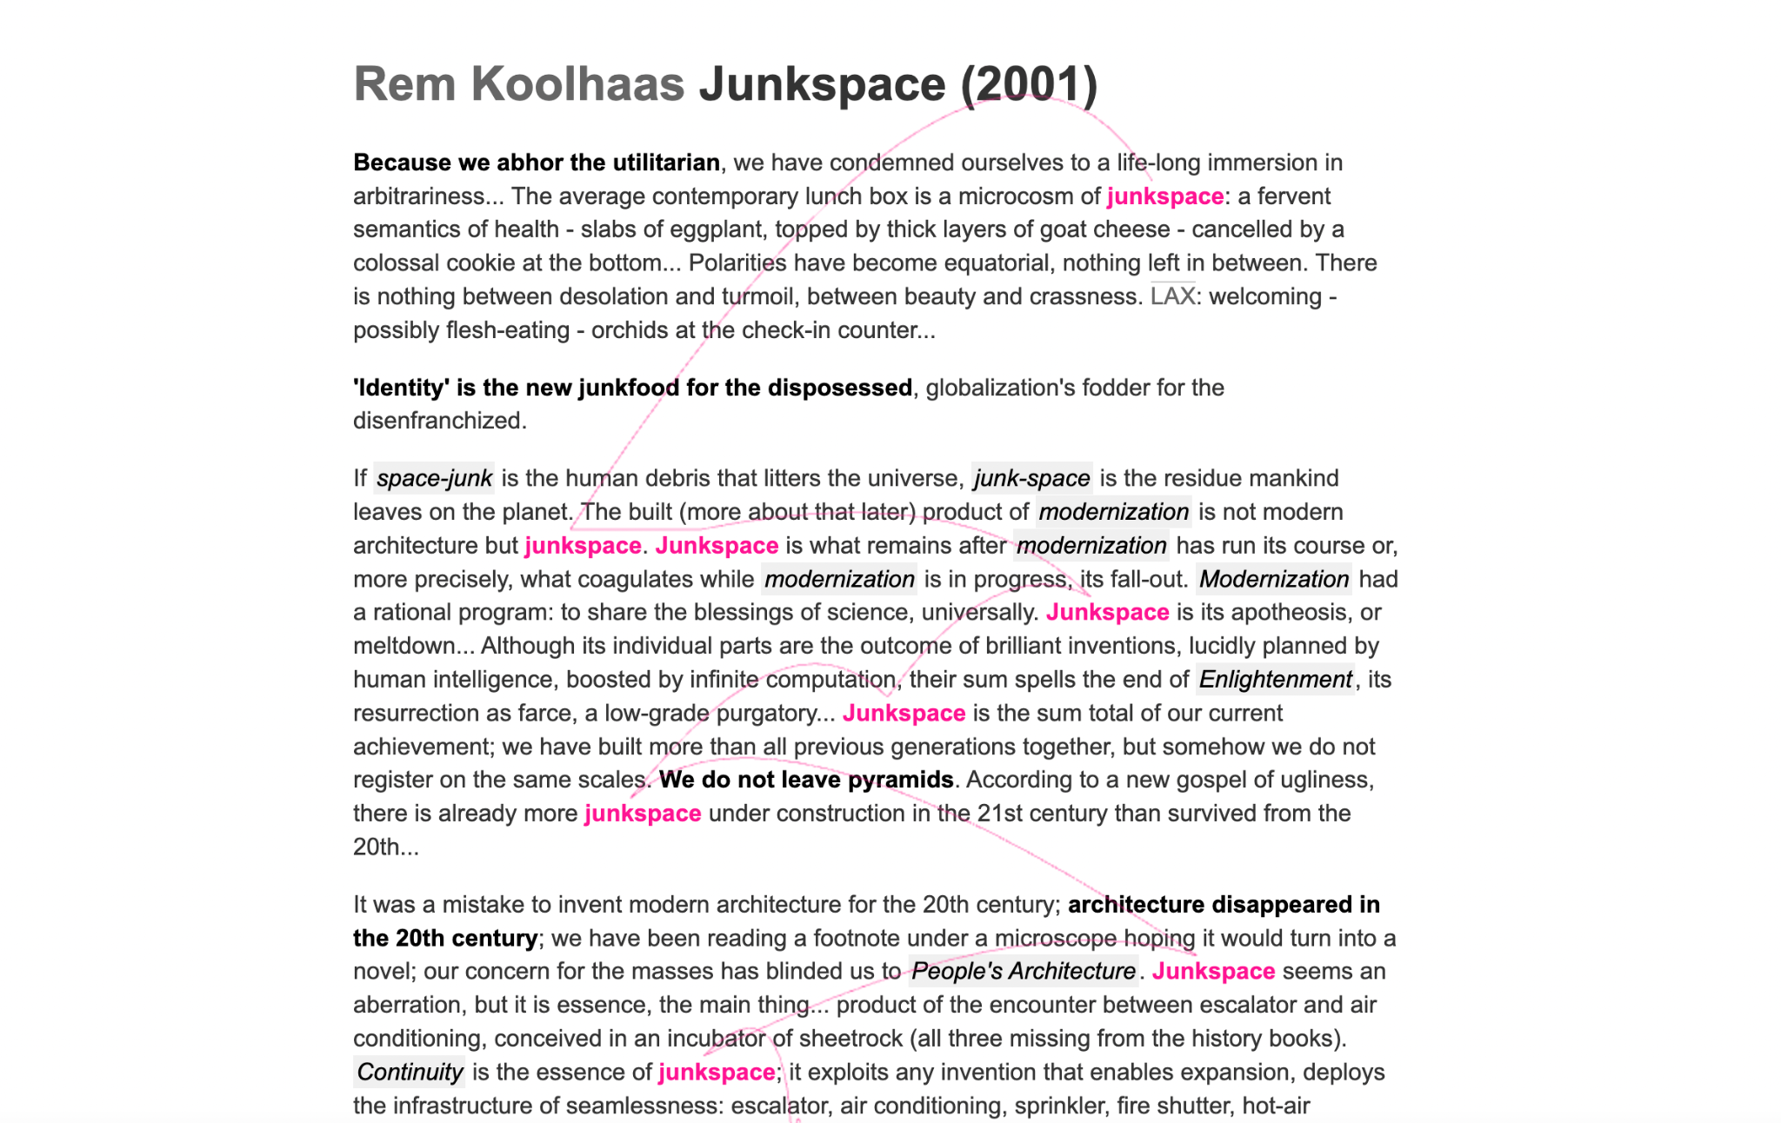
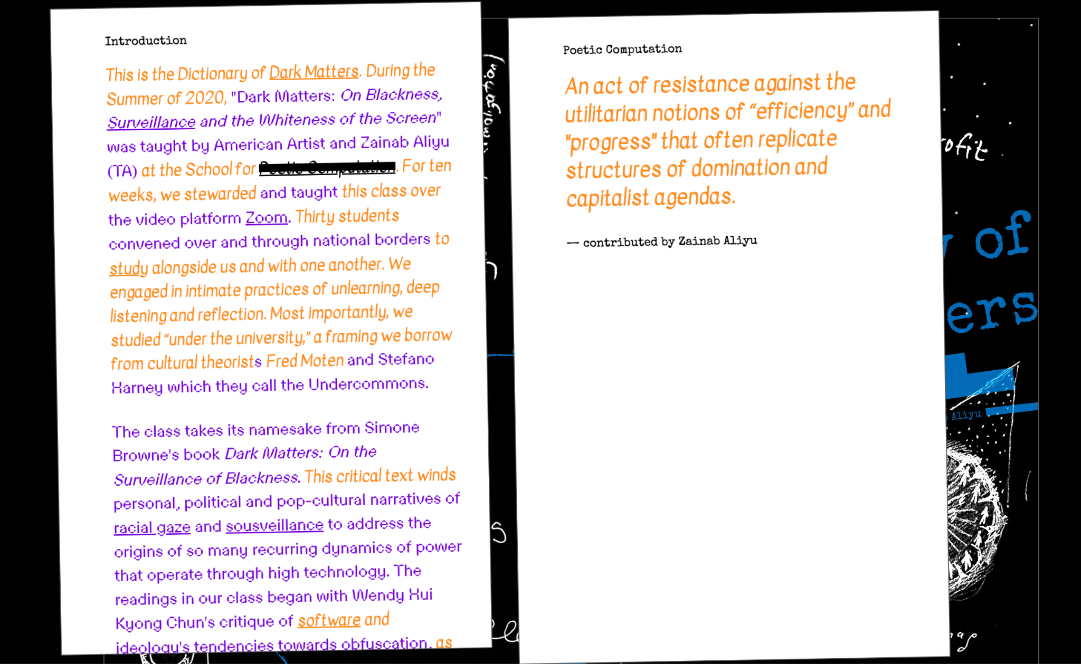
What I want to emphasize?
Annotated

Slide 8
END

